Slide 1
COMP-122 INTRODUCTION TO COMPUTER PROGRAMMING
Lecture 1: Introduction to Python programming
Language

Slide 2
Outline
Introduction to Python
Why learn Python
Applications of Python
Python IDLE
Notes:
Do not hesitate to ask!, If something is not clear, stop me and ask.
Coding is all about trial and error. Don't be afraid of it. Error messages aren't scary, they are useful.

Slide 3
Introduction
Python is a high-level, general-purpose and a very popular programming language.
Created by Guido van Rossum and first released in 1991
Useful as a scripting language
script: A small program meant for one-time use
Targeted towards small to medium sized projects
It is free and open source
Notes:
Developed by Guido van Rossum (now at Google)
Named after Monty Python
Other examples of scripting languages: Javascript, perl, ruby, php. Meaning you can download it for free and use it for any purpose, commercial or not.
Scripting languages do not require the compilation step and are rather interpreted.

Slide 4
Introduction Cont …
It is used for:
web development (server-side),
software development,
Remote Sensing Visualization
Exploring and modeling data in the field of Earth Sciences.
Used by:
Google, Yahoo!, YouTube
Notes:
NumPy
Pandas
Matplotlib
How does Google use Python?
Developers at Google use Python for a variety of system building, code evaluation tools, and system administration tools. Python can also be found in several Google APIs. The usage of Python has been growing especially heavily used for their data analysis, machine learning, artificial intelligence and robotic projects.

Slide 5
Why Learn Python?
Easier to learn and use than other programming languages
It’s usually much easier to read Python code and much faster to write code in Python than in other languages
Simple elegant syntax
Python takes coding like natural human-language
Portable
Python can run on a wide variety of hardware platforms and has the same interface on all platforms.
Notes:
Like C
#include <stdio.h>
int main(void) { printf("Hello, world\n"); }
Print(“Hello world”)
You can use on smartphone - pydroid

Slide 6
Why Learn Python Cont…
Very flexible
You don't need to define the type of a variable in Python.
As a dynamically typed language, Python is really flexible. This means there are no hard rules on how to build features, and you'll have more flexibility solving problems using different methods.
Extensive support libraries
There are a lot of libraries to work with; numPy, pandas , matplotlib
Notes:
The library contains built-in modules (written in C) that provide access to system functionality such as file I/O that would otherwise be inaccessible to Python

Slide 7
Applications of Python
Python has several applications in the real world, for instance;
In the medical field it can be used for predictive analytics for diseases.
Game and Web development.
Business applications
Data science
Machine learning

Slide 8
Installing Python
Windows:
Download the Python 3.9 from http://www.python.org
Run the python installer.
Run Idle from the Start Menu.
Mac OS X:
Python is already installed.
Open a terminal and run python or run Idle from Finder.
Linux:
Chances are you already have Python installed. To check, run python from the terminal.
If not, install from your distribution's package system.
Notes:
There are two well known version of python, version 2 and 3. Their main difference is how they implement print and input functions.
Example of both.
raw_input(string2) input(integer py2)

Slide 9
Python Interfaces
IDLE – a cross-platform Integrated Python development environment
Python Shell – running 'python' from the Command Line opens this interactive shell
Other text editors that support python code; VS code, Sublime, Pycharm etc.
For the exercises, we'll use IDLE, but you can try them all and pick a favorite

Slide 10
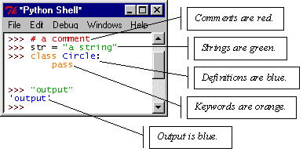
IDLE – Development Environment
IDLE helps you program in Python by:
color-coding your program code
debugging
auto-indent
interactive shell

Slide 11
The Python Interpreter
Interpreted:
Not compiled like Java
Code is written and then directly executed by an interpreter
Type commands into interpreter and see immediate results
Java:
Code
Compiler
Runtime
Environment
Computer
Python:
Code
Interpreter
Computer
Notes:
One of interpreted languages.
This implies that you can execute this language before even compiling your entire program.
Compiling: transforming Source Code (human readable) into machine code (computer executable). A compiler is a program. A compiler takes the recipe (code) for a new program (written in a high level language) and transforms this Code into a new language (Machine Language) that can be understood by the computer itself.

Slide 12
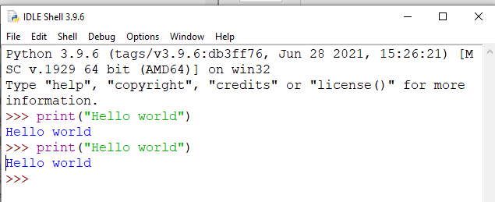
The Python Interpreter
Allows you to type commands one-at-a-time and see results
A great way to explore Python's syntax
Repeat previous command: Alt+P

Slide 13
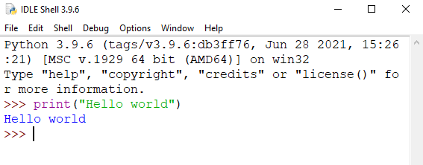
Our First Python Program
Hello World
print(“Hello world”)
Prints Hello world to standard out
Open IDLE and try it out yourself
Follow along using IDLE
Notes:
Python pseudocode is more like an algorithmic representation of the code involved. ... In simple terms, the Python pseudocode is a syntax-free representation of code. So, the Python pseudocode does not involve any code in it.
FUNTION function_name(parameters)
function body
RETURN value
ENDFUNCTION

Slide 14
The art and science of asking questions is the source of all knowledge. - Thomas Berger

